Slide 1
RECCCAP 24/25.02.2014
Systems & Realtime
Macros
Includes

Slide 2
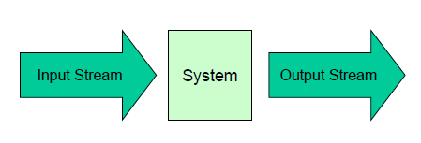
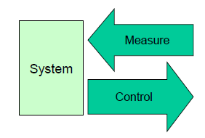
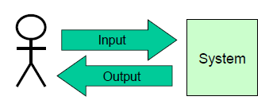
3 Embedded Systems
Transforming System
Throughput [Bytes/s]
Data processing quality
system utilization
Reactive System
ext. Events are driving system (closed loop control systems)
Guaranteed response time
Realtime
Interactive System
short response time
High system utilization
HMI

Slide 3
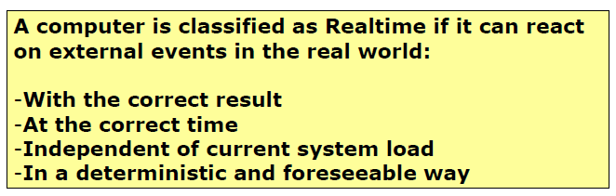
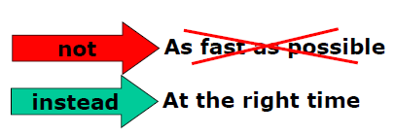
Realtime

Slide 4
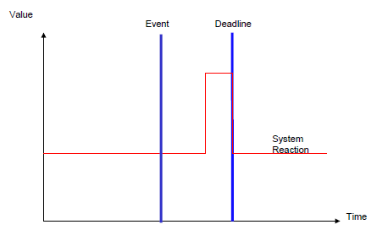
Hard Realtime (Airbag)
Incorrect if correct result does not meet with the time conditions

Slide 5
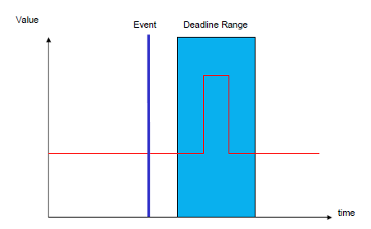
Soft Realtime (video encoder)
Degradation, if correct result does not meet the time conditions

Slide 6
Macros
Preprocessor instructions which replaced before the compile
Support the reusability
Platform.h or cofig.h

Slide 7
Macros
Textual replacement
Notes:
Place macros in platform.h or config.h

Slide 8
Macros
For configuration optional if-request

Slide 9
Includes
2 files:
*.c: implementation, definition
*.h: Interface/Header File: external Declaration
Local variables in *.c-File
Global varibles in *.h-File
<……> libraries
‘’……’’ h files

Slide 10
Includes
Problem: Recursive includes
Corrective:
Preprocessor-Definition: __<FileName>_H_

Slide 11
Questions
Name each one example for a transfoming system, reactive system and interactive system?
TS: Video encoder, RS: PID Controller, IS: ticket selling machine

Slide 12
Questions
Why schould placed everytime brackets on preprocessor commands with calculations?
Example:
#define CALC1 (2+5)
#define CALC2 (5*3)
In some situations it get calculated wrong.
Int example = 10*CALC1;
Without brackets: (10*2)+5

Slide 13
Questions
Advantages and disadvantages of Macros
Advantages:
Faster code
Smalle
Disadvantages:
Interface
Encapsulation
Debugging

Slide 14
Questions
How looks the definition of the led.h-Files to avoid recursive inclusion
#ifndef__LED_H_
#define__LED_H_
//expresions of the led.h file
#endif

Slide 15
Questions
How and where get global variables defined?
In the *.h file with the extension «extern»: extern intLED_global; Chose a good name with prefix because the Name is visible in the whole project.

Slide 16
Questions
Is it possible to include a picture or other files than *.h-Files and libraries?
Yes, to include a bmp: #include’’bmp.txt’’

